Slide 1
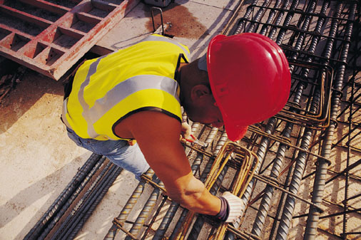
VIDEO ANALYTICS SOFTWARE FOR PIPE CRACK DETECTION AND WORKER SAFETY
BY TEAM CAVITY –
Kunal Parihar
Tabish Shaikh
Vivasvan Patel
Kshitij Garg
Samarth Singh
Pragya Srivastava

Slide 2
making software which can analyze different types of videos taken by HD camera / Drone / Robotic tools.
OUR AIM
video can analyze WHETHER OR NOT A PERSON has safety equipment WITH THEM, or software can analyze pipe cracks, etc.

Slide 3
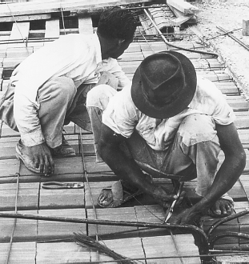
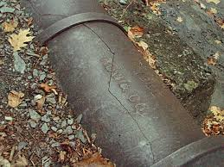
What we wish?
WORKER SAFETY
EARLY PIPE CRACK DETECTION TO AVOID COMPANY LOSSES.

Slide 4

Saving lives. Spreading smiles.

Slide 5
What does this software do?

Slide 6
reduce the risk of accident on construction site by spotting defects, which are not spotted by human eye.

Slide 7
Can spot defects like pipe cracks which can cause major trouble.

Slide 8
No human supervisor for safety needed. construction organizing department can save money. Automation increasing company’s profit.

Slide 9
How this can be achieved?

Slide 10
Reprocessing the image from the dataset. checking for contrast, brightness and normalizing it. Using image augmentation to generate more dataset.

Slide 11
passing the pre-processed image through convolutional neural networks(U-Net, PSP Net or the One Hundred Layers Tiramisu).

Slide 12
train large dataset of video images and take their classified output as ground truth. train these Convolutional Neural Networks (one per category of object class to predict) with Tensorflow on Nvidia Graphics processing unit(GPU).

Slide 13
Using different video processing technique to get faster and more accurate segmentation like Mask R-CNN.
Validate our model on validation data to get K-Fold accuracy.

Slide 14
WHAT IS THE OUTPUT THAT WE GOT FROM THIS SOFTWARE?

Slide 15
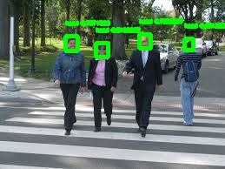
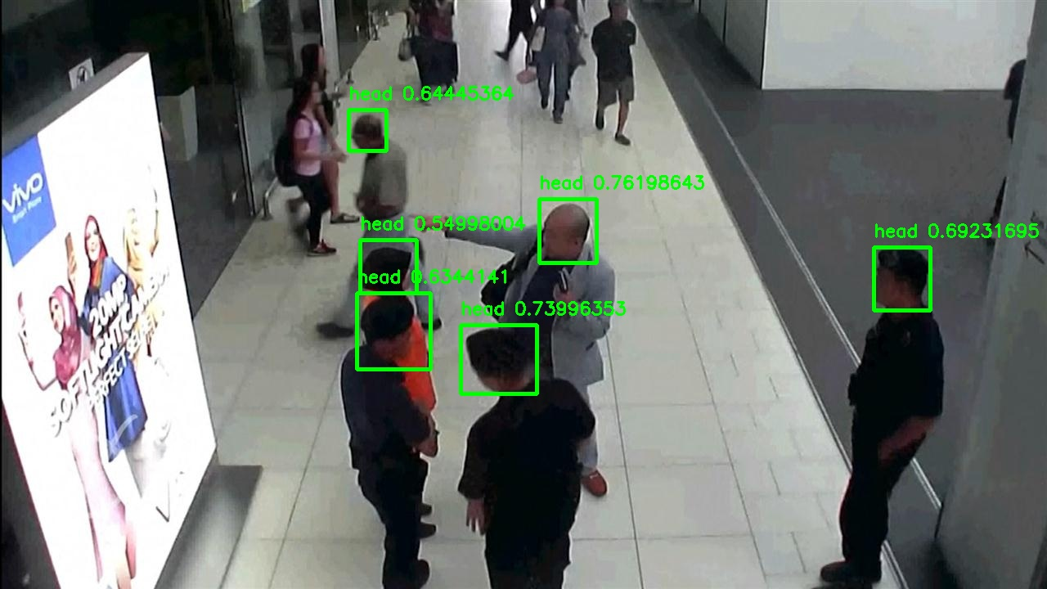
HEAD COUNT
YOLO BASED MODEL TO PREDICT NUMBER OF PEOPLE IN VIDEO FOOTAGE. THE MODEL ALSO GIVES THE STATISTICS ABOUT NUMBER OF PEOPLE WORKING WITH RESPECT TO TIME.

Slide 16
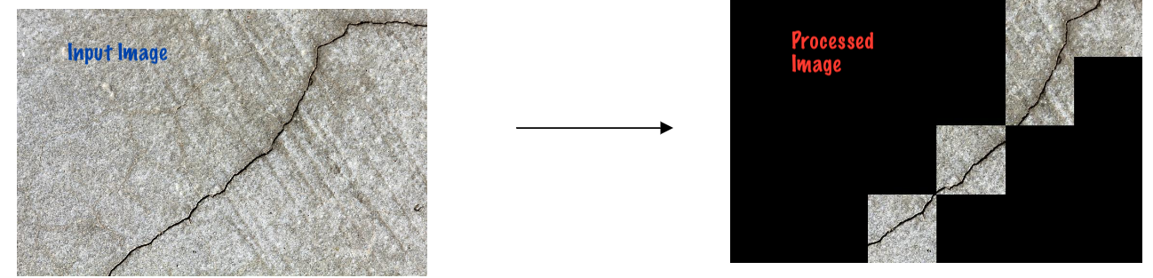
CONCRETE PIPE CRACK
DEEP LEARNING BASED CONCRETE CRACK DETECTION USING CONVOLUTIONAL NEURAL NETWORKS.MODEL ACHIEVED AN ACCURACY OF ABOUT 95%.

Slide 17
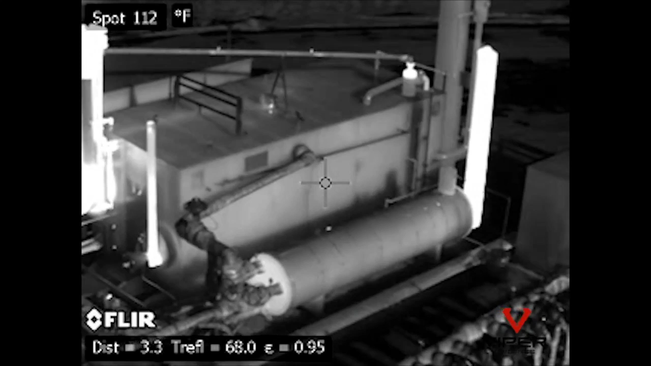
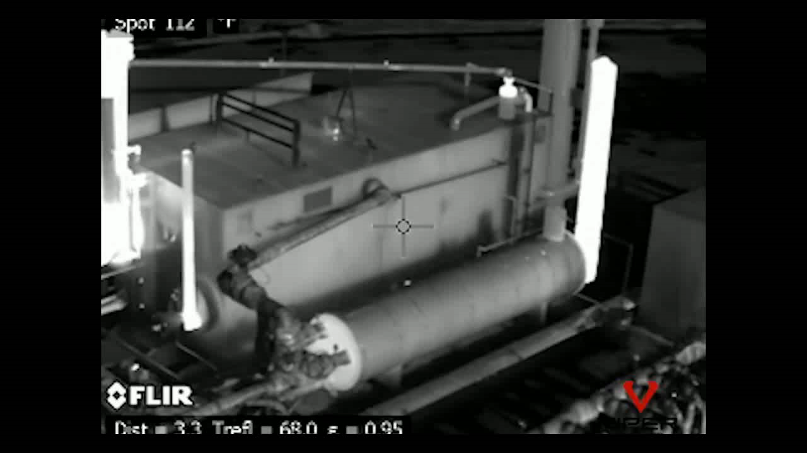
EXTERNAL PIPE CRACK DETECTION MODEL
INPUT VIDEO
OUTPUT VIDEO
WHEN STEAM IS DETECTED IN THE INPUT VIDEO , THAT PART OF THE VIDEO WILL START MOVING FRAME BY FRAME AS YOU CAN SEE IN THE OUTPUT VIDEO.

Slide 18
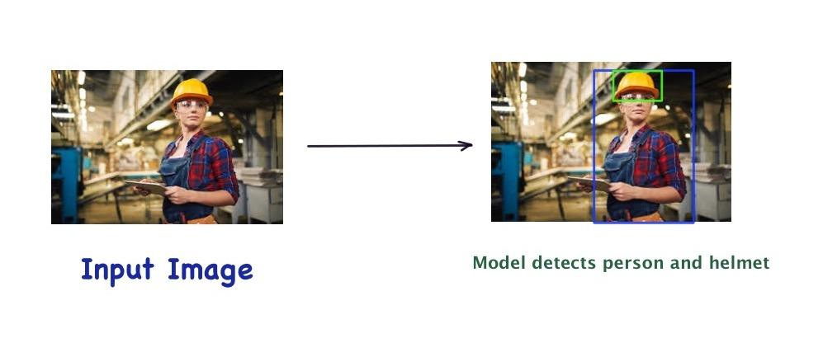
HELMET DETECTION
YOLO BASED MODEL TO DETECT HELMET . MODEL CLASSIFIES THE IMAGE OF PERSON WEARING HELMET OR PERSON WITHOUT HELMET.

Slide 19
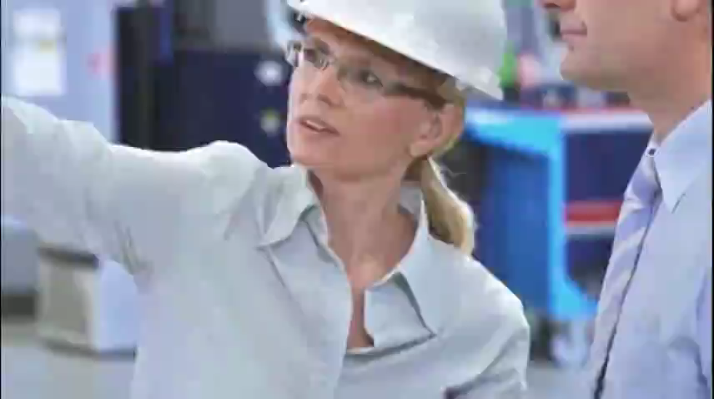
HELMET DETECTION MODEL
THE MODEL IDENTIFIES A PERSON WITH HELMET AND MENTIONS IT ABOVE THE GREEN BOX AS SEEN IN THE VIDEO BELOW.

Slide 20
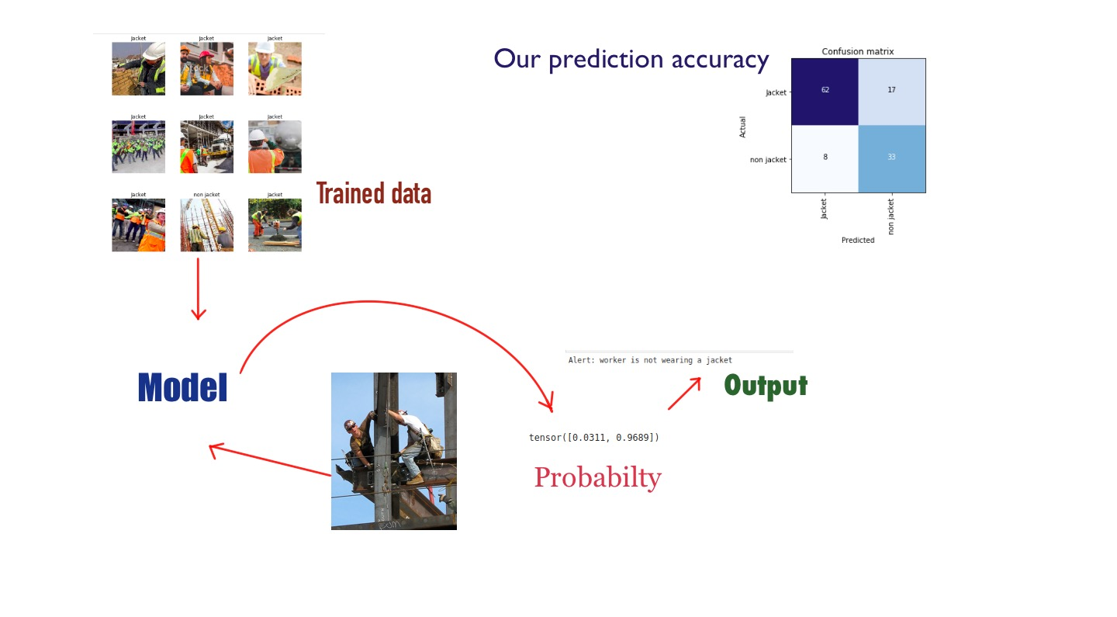
JACKET DETECTION
YOLO BASED MODEL TO DETECT JACKET . MODEL CLASSIFIES THE IMAGE OF PERSON WEARING JACKET OR PERSON WITHOUT JACKET.

Slide 21

JACKET DETECTION MODEL
THE MODEL IDENTIFIES PEOPLE WITHOUT JACKET BY SURROUNDING THE FRAME WITH BLUE COLOUR BOX , ELSE IT SURROUNDS IT WITH BLACK COLOUR BOX ,AS SEEN IN THE VIDEO BELOW.

Slide 22
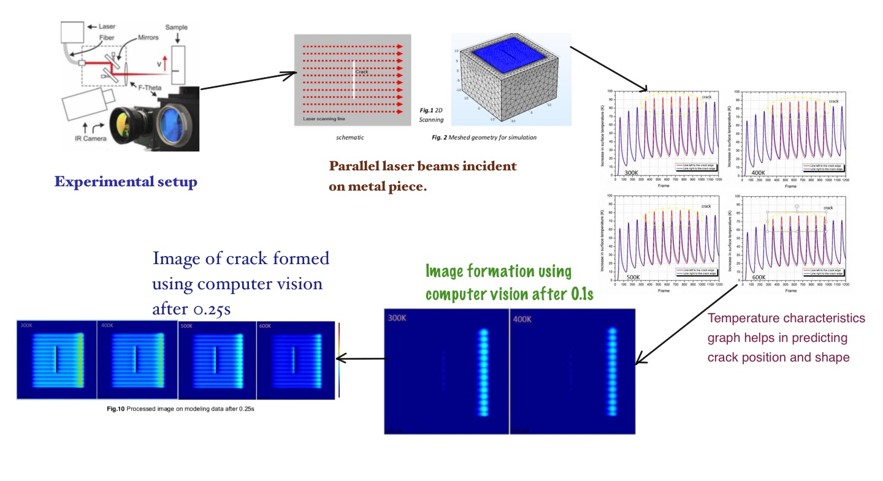
INTERNAL PIPE CRACK DETECTION
USING IN-LINE LASER THERMOGRAPHY AT ELEVATED TEMPERATURE FOR INTERNAL PIPE CRACK DETECTION.

Slide 23
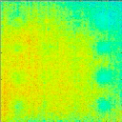
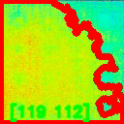
Internal pipe crack detection model
INPUT VIDEO
OUTPUT VIDEO
THE INPUT VIDEO IS TAKEN BY INFRARED MAPPING OF THE INSIDE OF THE PIPE. WHEREVER THERE IS A CRACK,THAT AREA WILL TURN RED AND THE ACCORDING COORDINATES OF THE CRACK IS DISPLAYED IN THE OUTPUT VIDEO .

